Slide 1
Covid-19 in Singapore

Slide 2
Table of Contents
Overview of Covid-19 in Singapore
Stages of transmission
3. Covid-19 Cases Allocation
4. Covid-19 Local Cases Forecasting

Slide 3
Sources
Data Sources:
Singapore Ministry of Health: https://www.moh.gov.sg/
Covid-19 Singapore: https://data.world/hxchua/covid-19-singapore
Google Earth
2. Code Sources:
Time-series hands-on tutorial by teachers in D.A class
Data Science Tutotials: https://www.youtube.com/channel/UCk5tiFqPvdjsl7yT4mmokmg
3. Project Github Link:
https://github.com/hoanglinh171/Covid-19-Singapore

Slide 4
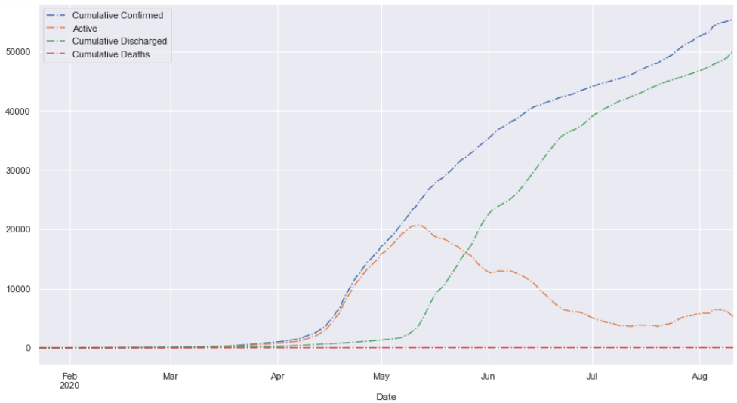
Overview
Confirmed: 55353
Active: 5178
Recovered: 50148
Death: 27

Slide 5
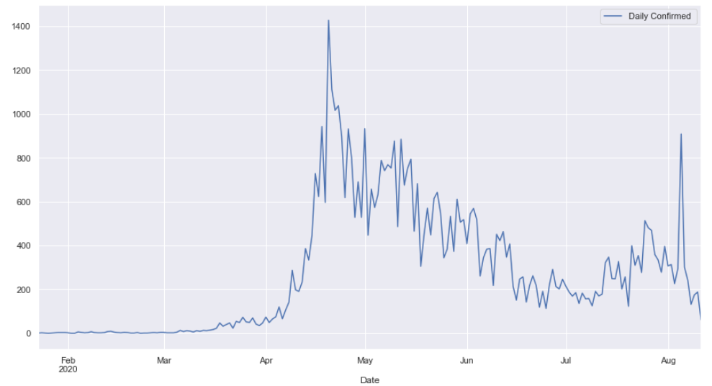
Overview

Slide 6
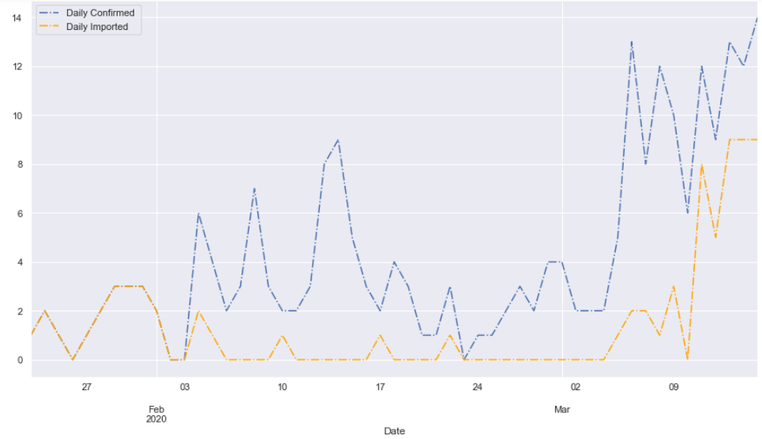
Stages of transmission: Wave 1 & 2
Imported Cases

Slide 7
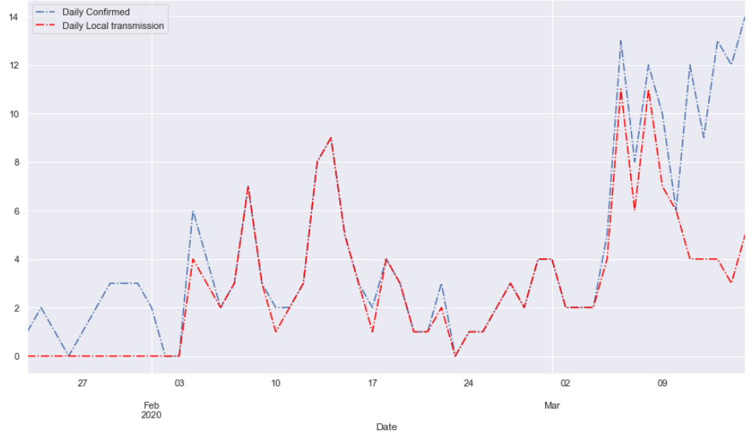
Stages of transmission: Wave 1 & 2
Local Cases

Slide 8
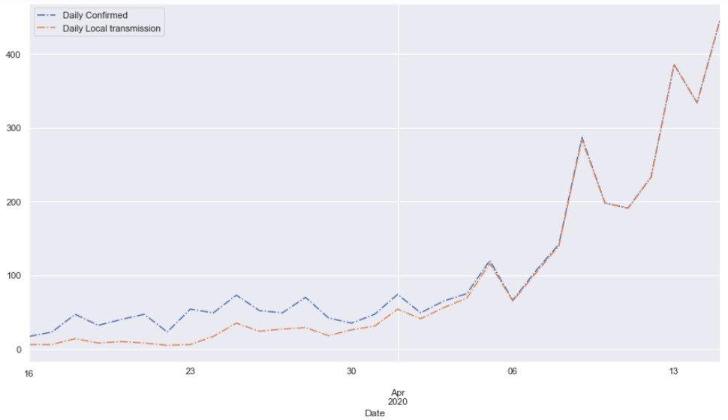
Stages of transmission: Wave 3
Local Cases

Slide 9
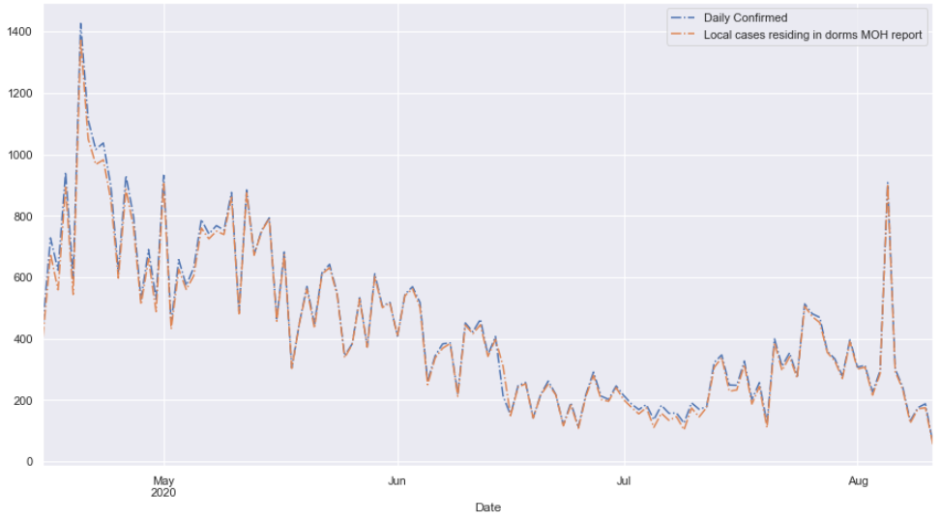
Stages of transmission: Wave 4 & 5
Local Cases Residing in Dorms

Slide 10
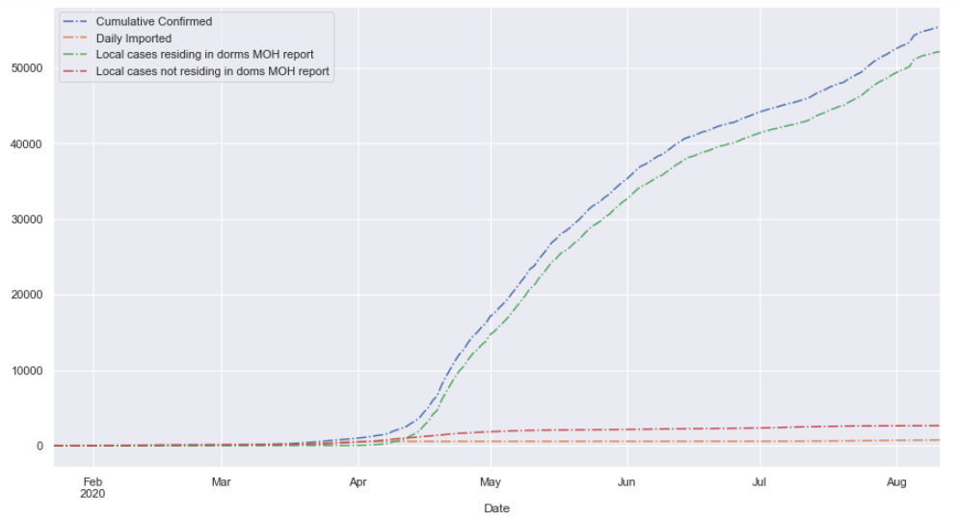
Covid 19 Cases Allocation

Slide 11
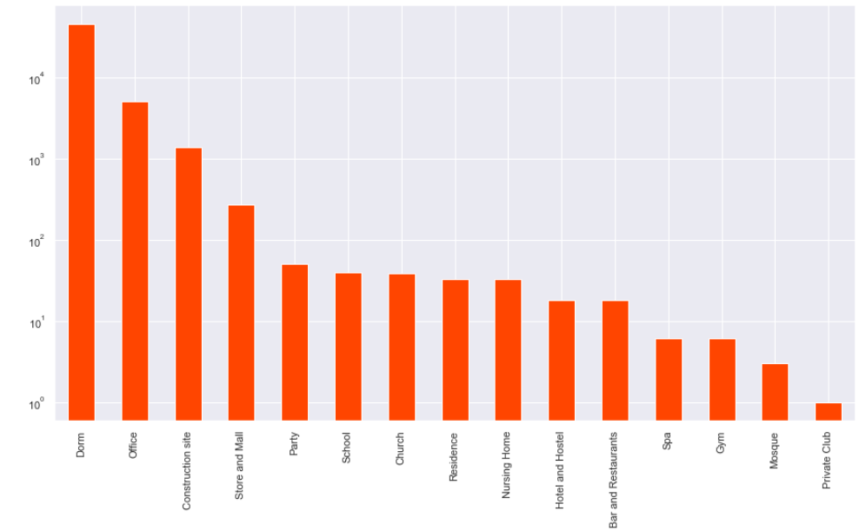
Covid 19 Case Allocation

Slide 12
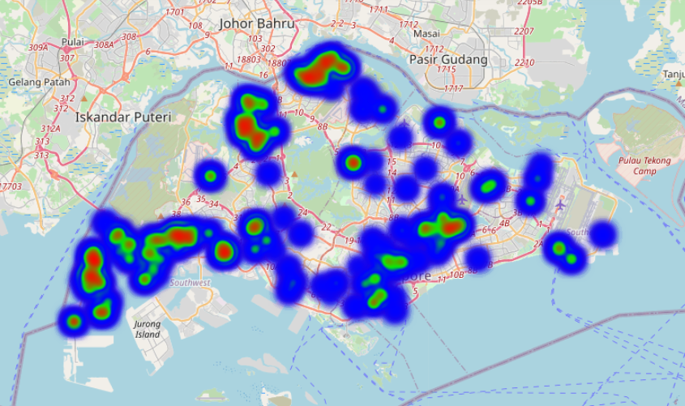
Covid 19 Case Allocation

Slide 13
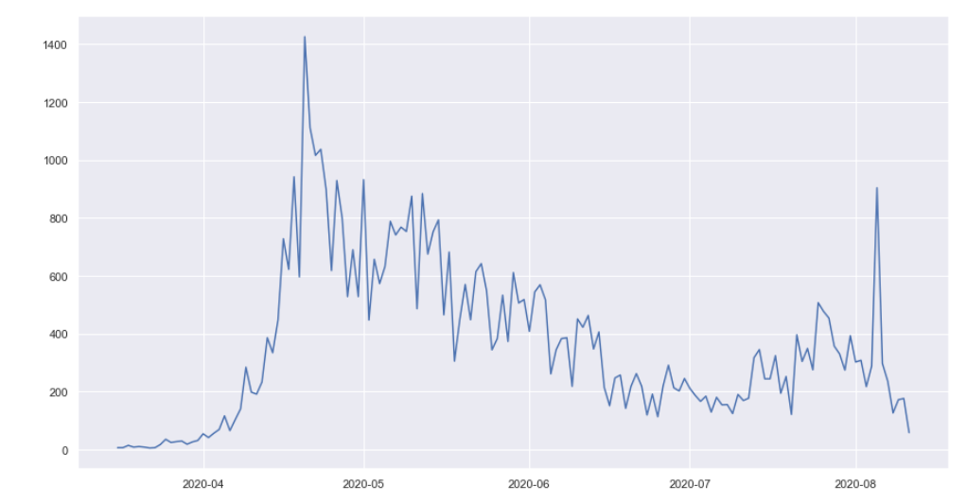
Covid 19 Local Cases Forecasting

Slide 14
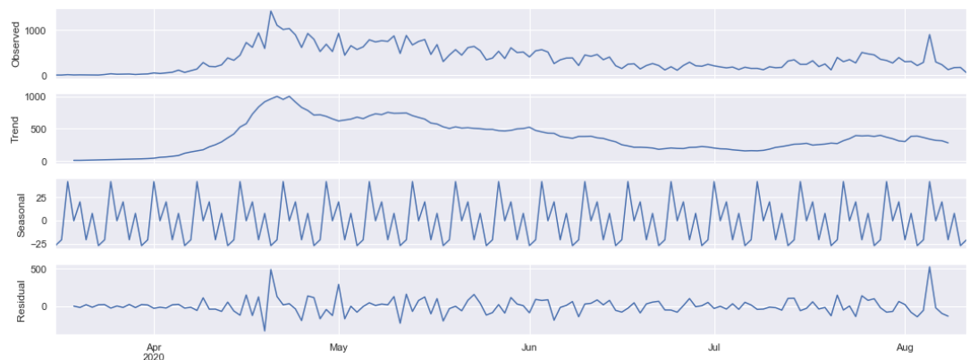
Covid 19 Local Cases Forecasting

Slide 15
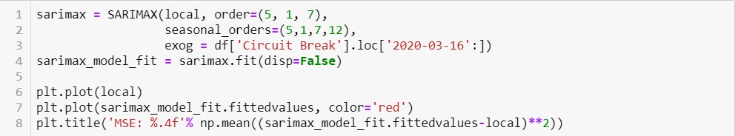
Covid 19 Local Cases Forecasting
SARIMAX Model to deal with:
Trend
Seasonality
Exogenous Variable: External Factor (Social Lockdown)

Slide 16
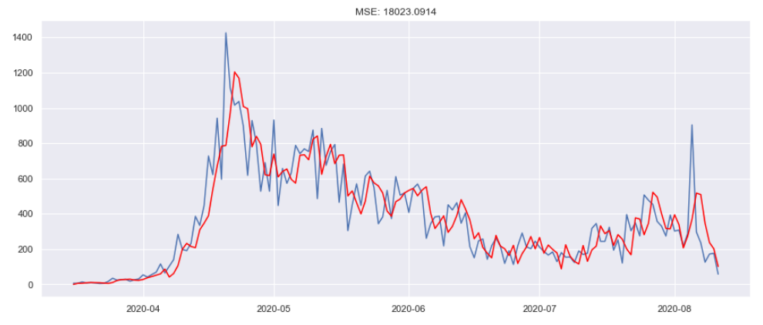
Covid 19 Local Cases Forecasting

Slide 17
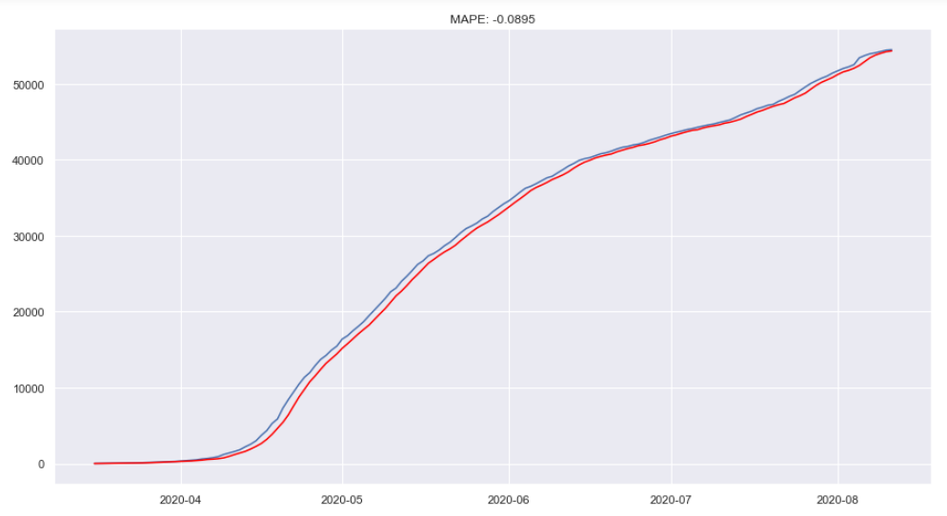
Covid 19 Local Cases Forecasting

